Slide 1

Deloitte Pre Hire training
2017
FOUNDATION TRAINING
ORM With Hibernate

Slide 2
ORM with Hibernate 3.5
Criteria Query

Slide 3
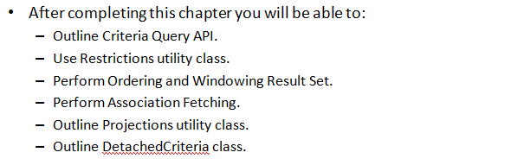
Objectives

Slide 4
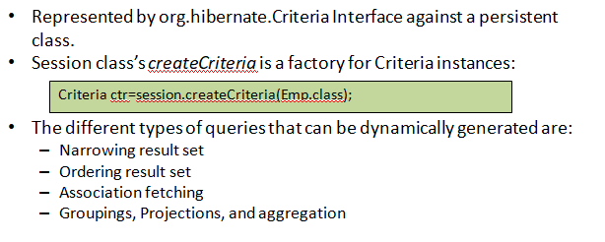
Criteria Query API

Slide 5
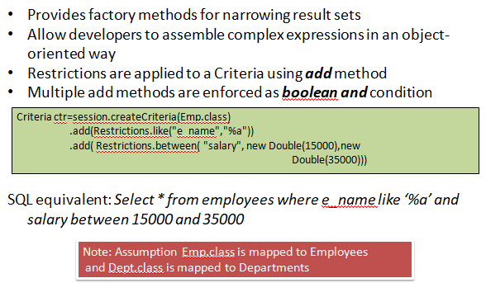
Restrictions Class

Slide 6
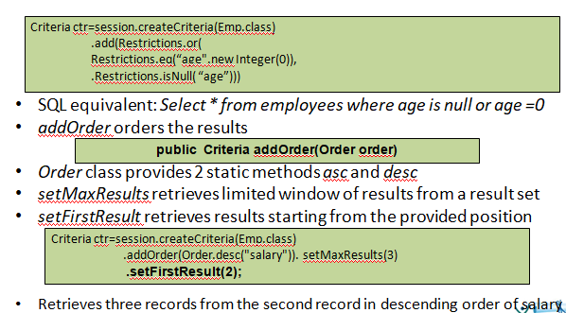
Ordering and Windowing Result

Slide 7
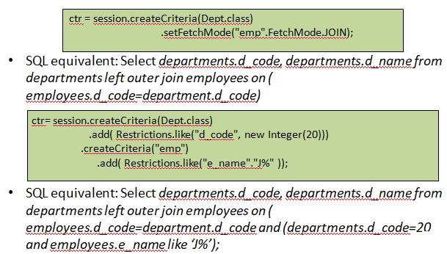
Fetching Association

Slide 8
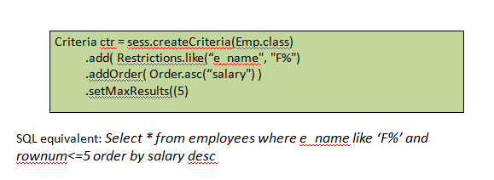
Ordering Result

Slide 9
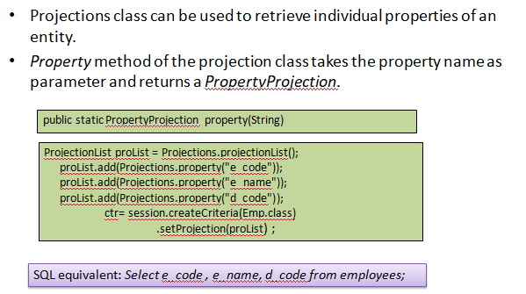
Projections : Property Projection

Slide 10
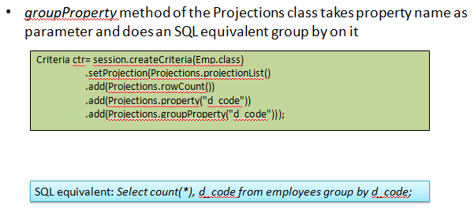
Projections : Group Property

Slide 11
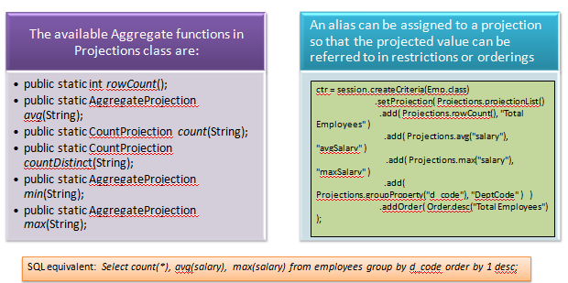
Projections : Aggregate Function

Slide 12
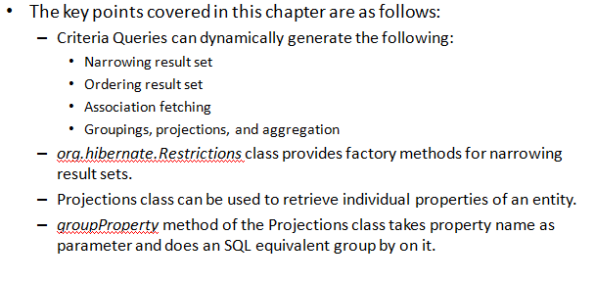
Summary

